Slide 1

Decentralized Traceability and Direct Selling of Agriculture Supply Chains
by
S. Shabana
Roll No. 204G1A0595
N. Sai Charan Reddy
Roll No. 204G1A0584
G. Sai Pranav Reddy
Roll No. 204G1A0590
C. Sushmitha
Roll No. 204G1A05A6
Under the guidance of
Mr. M. Narasimhulu M. Tech, (Ph.D)
Assistant Professor
Department of Computer Science and Engineering
Srinivasa Ramanujan Institute of Technology
(Autonomous)
2023 - 2024

Slide 2

Contents
Abstract
Problem statement
Objectives of Project
Literature survey for first objective
Literature survey for second objective
Proposed Work - (Methods to be followed for proposed system)
References
GitHub Link
Queries

Slide 3
Abstract
One of the major challenges the agriculture sector facing today is lack of Direct Supply Chain between Farmers and Buyers. The involvement of multiple intermediaries adds high costs and reduces profit for the farmers. In the end, farmers are left with minimal income, and users may not get quality products.
The idea is to develop a portal which establish Direct Marketing channel between Farmers and Buyers using IoT technology. Through this portal, The farmers can sell their products in a more transparent manner. Block chain is a revolutionary technology, capable of ensuring commodity traceability in agriculture and in food supply chains.This system ensures security through the decentralized structure, thereby reducing the risk of fraudulent activities by intermediaries.
Notes:
Direct selling, multiple agents remove,

Slide 4
Problem Statement
Enhancing Agricultural Supply Chain Efficiency by reducing fradulence risk through IoT and Blockchain Technology.
The current agricultural supply chain processes suffer from various inefficiencies and vulnerabilities that hinder the growth and sustainability of the ecosystem.
The traditional centralized systems used in the supply chain fail to provide a clear and reliable record of product quality, origin, and movement.
This lack of transparency leads to dissatisfaction among consumers and affects the overall credibility of the agricultural industry.

Slide 5
Objectives of Project
To help farmers to sell their products in a direct and transparent manner by eliminating intermediaries.
To empower farmers by giving awareness on the markets. This helps them in taking better decisions and enhancing their profitability.
Notes:
Removed gap after first point

Slide 6
Literature survey for first objective
The traditional supply chains are centralized and they depend on a third party for trading. These centralized systems lack transparency, accountability and auditability. At the same time, consumers are now more interested in food product quality.
The traceability of Agriculture food supply chain management is important to ensure the food safety. It also increases the customer satisfaction and peer-to-peer productivity.
The centralized data storage makes it more difficult to assure quality, rate and origin of the products. So we are in need of a decentralized system where transparency is available which makes people from the producers to consumers satisfaction.

Slide 7
Literature survey for second objective
Farmers lack of awareness about market prices affects their ability to negotiate effectively with intermediaries and buyers, often leading to lower income for their produce.
Blockchain’s transparent and immutable nature can enable farmers to have transparent visibility into transaction history, ensuring fair pricing and reducing the risk of fraud.
The agricultural blockchain solution can reshape farmer-consumer-intermediary dynamics, revolutionizing the industry.
The interface is developed for buyers to access the farmer’s details and process transactions vice versa.
Notes:
Government and market is removed –buyers is added in last point

Slide 8
Proposed System
The proposed system provides a direct selling from farmer to buyer.
This system contains a IoT device. Every farmer has unique RFID tags so identifying the farmer is easy. When farmer enter the selling place with their products, the government officers fetch the details of the farmers using RFID reader and also the details of farmer are updated in webpage. The weight sensor is used to measure the weight of the products.
Block chain is a distributed database containing all networked transactions. Each part of this database is a “block”, a block with a connection to the previous block is added to the block chain in a linear and sequential order.
Ethereum is a public blockchain, meaning that the data and transactions are visible to all participants. This promotes transparency and reduces the risk of fraud.

Slide 9
References
Shivendra,Chiranjeevi,K.,Tipathi,M.K.,&Maktedar, “Block chain Technology in Agriculture Product Supply Chain”.
K. Salah N. Nizamuddin R. Jayaraman and M. Omar "Blockchain-based soybean traceability in agricultural supply chain" IEEE Access vol. 7 pp. 73295-73305 2019.
M. M. Aung and Y. S. Chang, “Traceability in a food supply chain: Safety and quality perspectives”.
S. Madumidha, P. Siva , U. Vandhana, B.Venmuhilan “A Theoretical Implementation: Agriculture-Food Supply Chain Management using Blockchain Technology”.
Notes:
4th reference has no url,2nd one also not working… 1st reference looks perfect, migatha anni kuda alane pettu-ok done

Slide 10
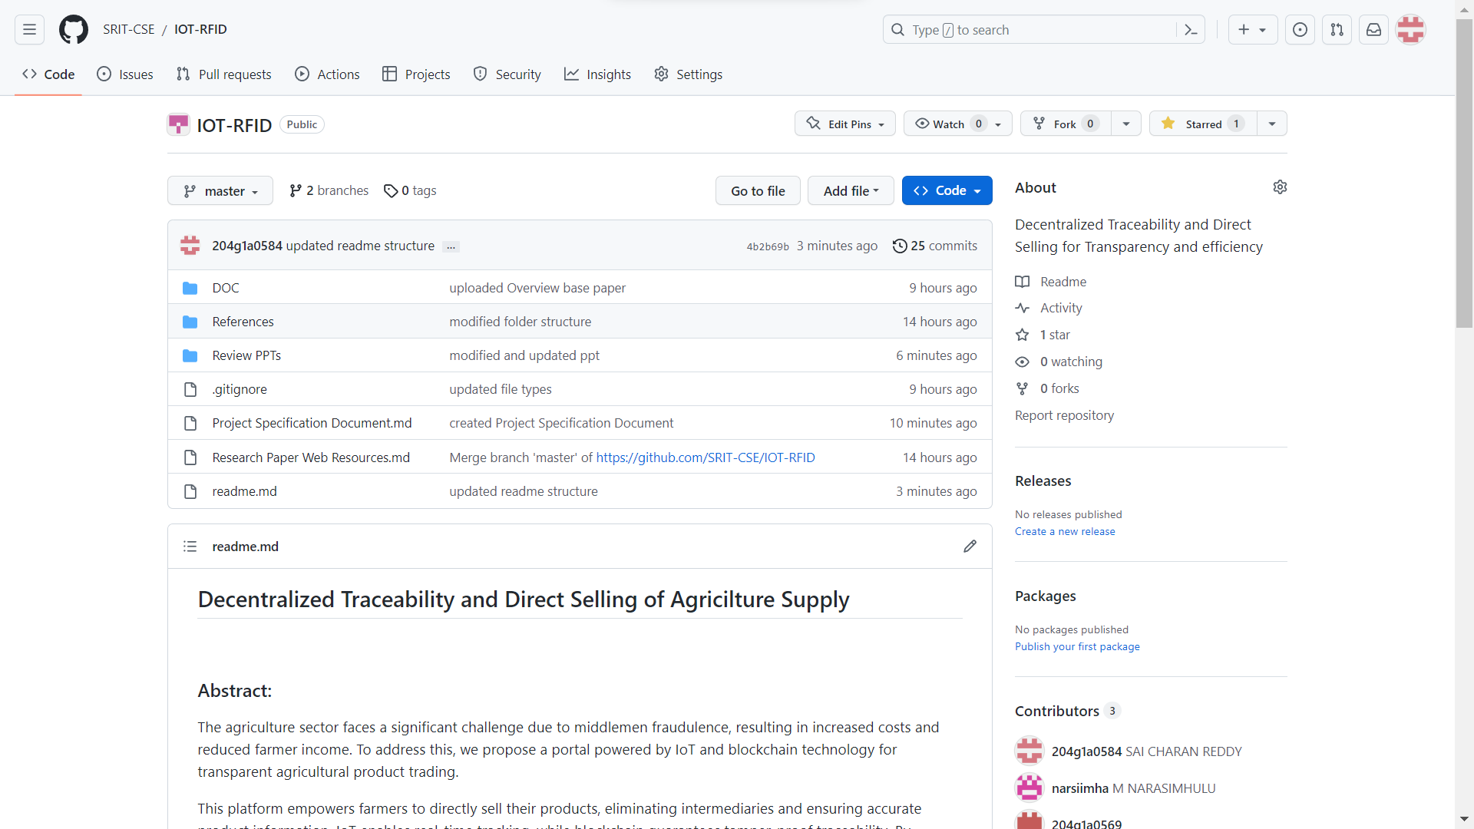
GitHub Dashboards of each student
Github Dashboards of each student
Github link:
https://github.com/SRIT-CSE/IOT-RFID.git
Notes:
Why changed the header background color to red? put the same as template and position in properly-done

Slide 11
Any Queries?
Notes:
Done!! Once you are done update the notes in each page, so that again we can verify

